Slide 1
Leading in a changing world of work
Structure and profile of the
World Employment Confederation
Corporate Presentation
www.wecglobal.org
2019
@WECglobal

Slide 2

Content
Membership policy
Mission and guiding principles
The voice of the Employment industry
Key activities
Advocating priorities
Services to members
Governance
Head Office

Slide 3



What is the World Employment Confederation?
A Membership organisation
A catalyst for its members’ growth
Grouping both National Federations & Corporate Members
Serving members on 5 key pillars
Non-profit purpose
The Voice of Labour Market Enablers
Representing the Employment industry at large
Promoting the added value of our industry (4 enabling functions)
Reliable source of data & insights
A Leader in a Changing World of Work
A thought leader within the World of Work
An expert on new ways of sourcing & deploying workforce
Educating stakeholders on changing world of work
Setting quality standards

Slide 4

Key facts and figures
The only authoritative voice for the employment industry since 1967 with members from 50 countries
Bringing together 169,000 employment agencies with 1,5 million HR specialists staff, including 8 of the largest worldwide businesses as direct corporate members
Represents the full spectrum of HR services, including
agency work, recruitment, career management, RPO & MSP
Working closely with international stakeholders, including ILO, OECD, IOM, World Bank, IOE, EU institutions
Offering access to the labour market for 50 million workers, 43 million of which through agency work

Slide 5


History of the World Employment Confederation
Key dates
Creation (as Ciett)
ILO C181
EU Directive on AW
50th Anniversary
Established in Paris with over goal to amend ILO position on private employment services
The ILO adopted convention n°181 on private employment services recognising positive role
The EU adopted a long-awaited Directive on agency work, providing for appropriate regulation on industry at European level
Celebrating its 50th anniversary in Paris with a Secretariat of 5 FTEs
1987
2005
2016
1967
1997
2008
2017
20th Anniversary
Permanent Secretariat
New name and logo
Back to Paris for celebrating its 20th anniversary during large employment conference
Insourcing of Secretariat based in Brussels and managed by Denis Pennel – New logo for Ciett
Repositioning the confederation in the context of the 21st century labour market to make aware of the breadth of value the industry brings to a fast changing world of work

Slide 6

Positioning the industry
The Proof Points as labour market enablers

Slide 7
Services delivered by the members of the World Employment Confederation

Slide 8
Positioning the Employment Industry
The 5 HR Services represented by the World Employment Confederation
Agency Work
Direct Recruitment
Career Management
Managed Services Providers
Recruitment Process Outsourcing

Slide 9
Membership Policy
Section 01

Slide 10







A global confederation
Luxembourg
Netherlands
Norway
Poland
Portugal
Romania
Russia
Slovakia
Slovenia
Spain
Sweden
Switzerland
Turkey
UK
China
Japan
South Korea
Austria
Belgium
Bulgaria
Croatia
Czech Republic
Denmark
Estonia
Finland
France
Germany
Greece
Hungary
Ireland
Italy
Latvia
Lithuania
Canada
Mexico
USA
Argentina
Brazil
Chile
Colombia
Peru
Australia
India
Indonesia
New Zealand
Philippines
Singapore
Vietnam
Morocco
South Africa

Slide 11









Corporate Members

Slide 12
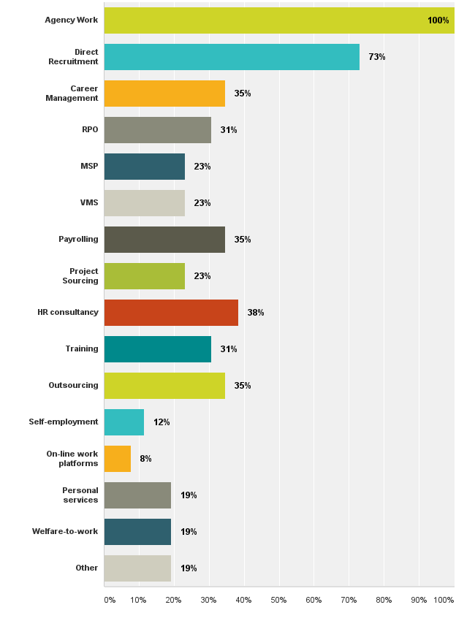
HR services represented by Members
Members of the World Employment Confederation represent a large range of HR services
Agency Work being the common one for all of them
Which HR services is your national federation officially mandated to represent?

Slide 13
Mission and
Guiding Principles
Section 02

Slide 14
What are our guiding principles
Work is an essential part of people’s life and identity
Dynamic labour market need facilitating intermediaries and transitions agents
Freedom of choice in the labour market should be promoted to meet the variety of work expectations and increase labour market participation
Appropriate regulation on employment services is needed in order to reach a balance between workers’ protection and well funtioning labour markets

Slide 15




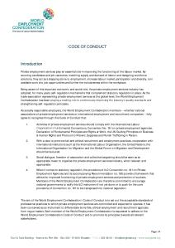

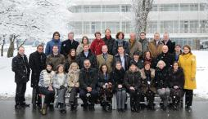

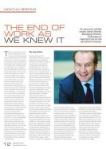
Our mission
Advocating (safeguarding interests)
Lobbying
Profiling the industry
Dialogue with social partners
Market Development
Membership expansion
Capacity building
Sharing practices
Quality standards
Thought leadership
Research & data collection
Educating on changing world of work
Conferencing
Networking with opinion leaders

Slide 16

















Key global external stakeholders
Research bodies
Social partners
United Nations
Intergovernmental
Networks

Slide 17
Advocating: What are our guiding principles
The World Employment Confederation…
  Recognises that work is an essential part of people’s life and identity
  Believes that diverse forms of work should be promoted to meet the variety of expectations and improve labour market inclusiveness
  Is convinced that enabling intermediaries and innovative workforce solutions are needed to simplify the increasing complexity of the labour markets
  Calls for appropriate regulation to be adopted on the employment industry in order to facilitate adaptation to a changing world of work:
    If no regulation in place, provisions of ILO Convention n°181 to be used as a base
    If too many outdated, unjustified restrictions, regulation should be eased
  Sets the highest standards to ensure the industry is respected and reputable and seen as a critical contributor to economic prosperity
  Commits itself to actively promote fair & ethical recruitment practices in order to reduce informal work and workers’ exploitation
  Believes that social dialogue can play – where relevant - a key role in reaching appropriate regulation on the employment industry

Slide 18
The voice of the Employment Industry
Section 03

Slide 19
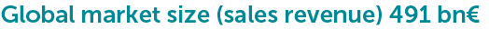
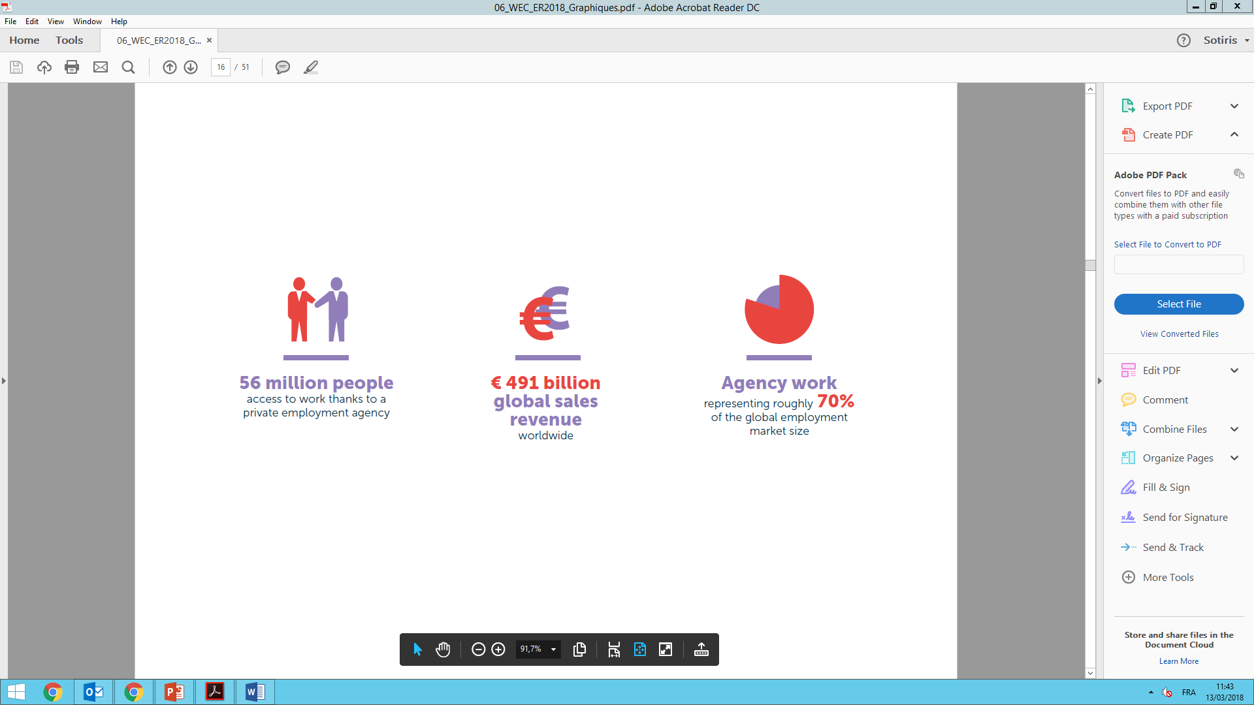

Global jobs market in 2016
All sectors on the rise – increasing demand for temporary jobs

Slide 20
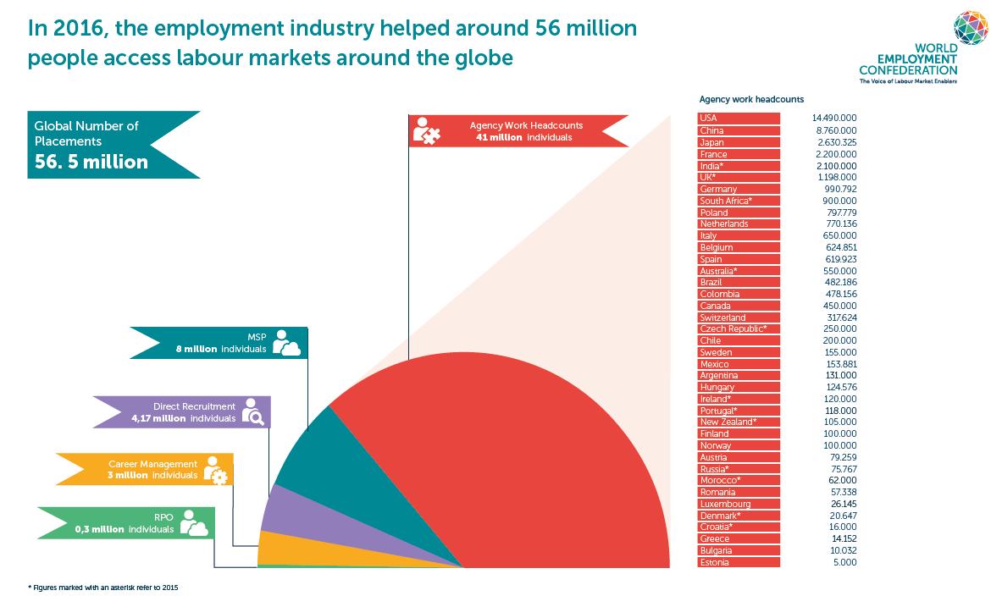
Impact on labour markets
Total number of placements

Slide 21
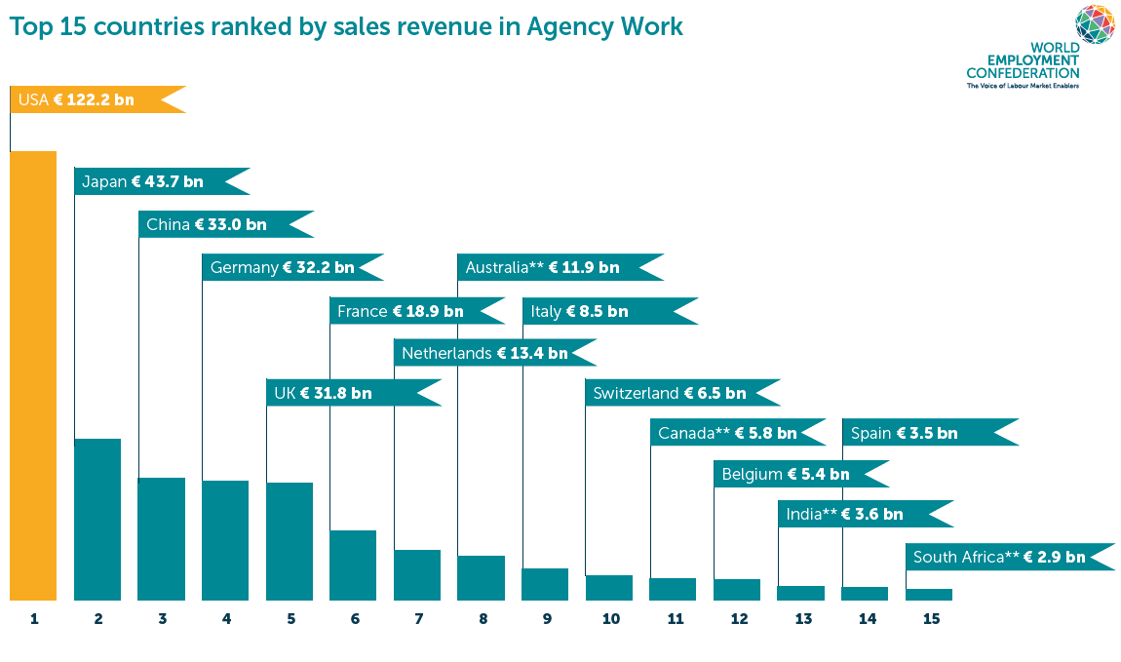
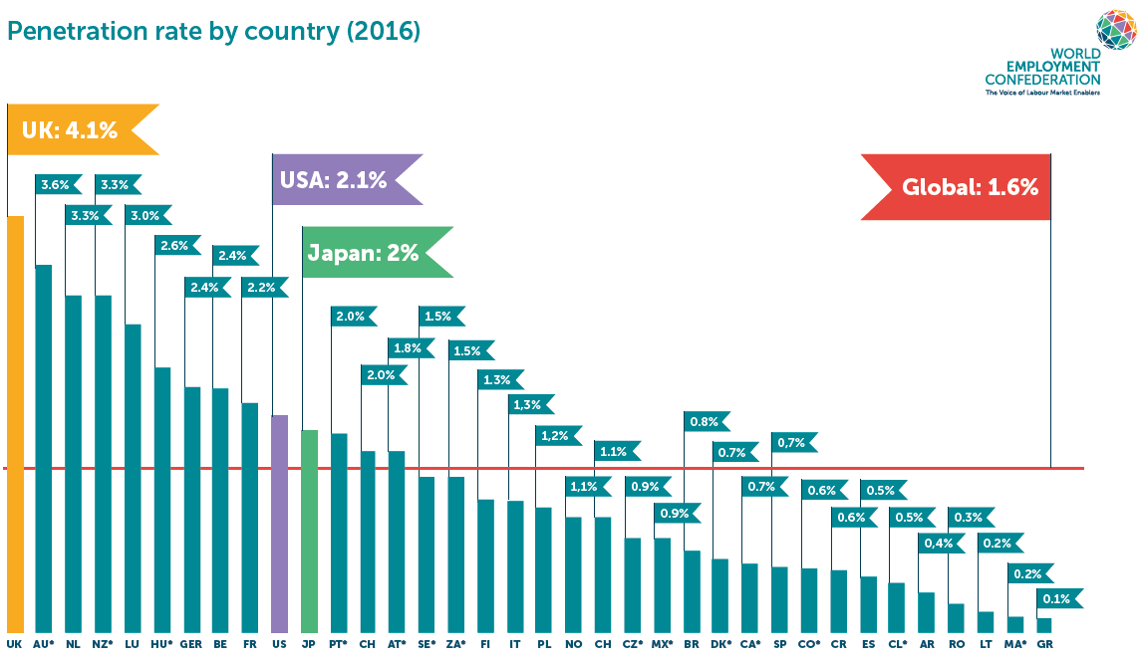


Agency Work
A handful of major markets drive growth

Slide 22
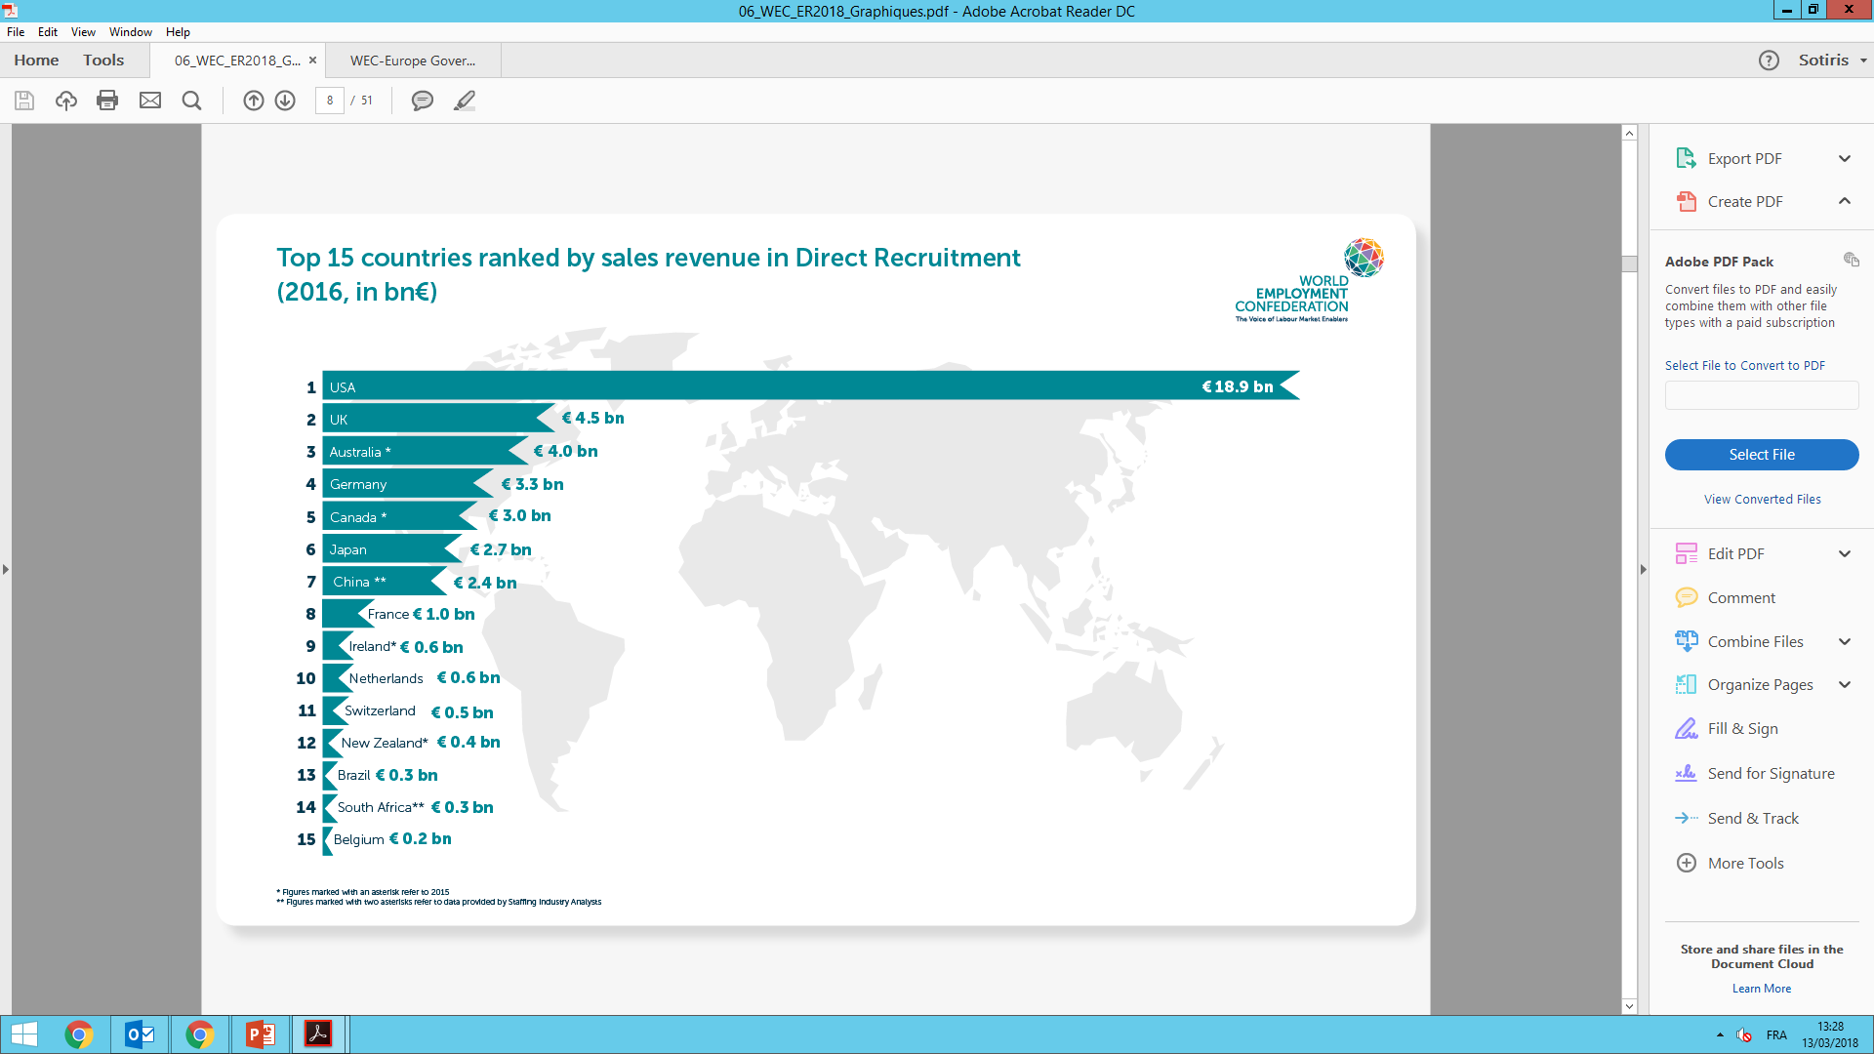
Direct Recruitment
Global Direct Recruitment market worth €38 bn, the US by far the largest.

Slide 23
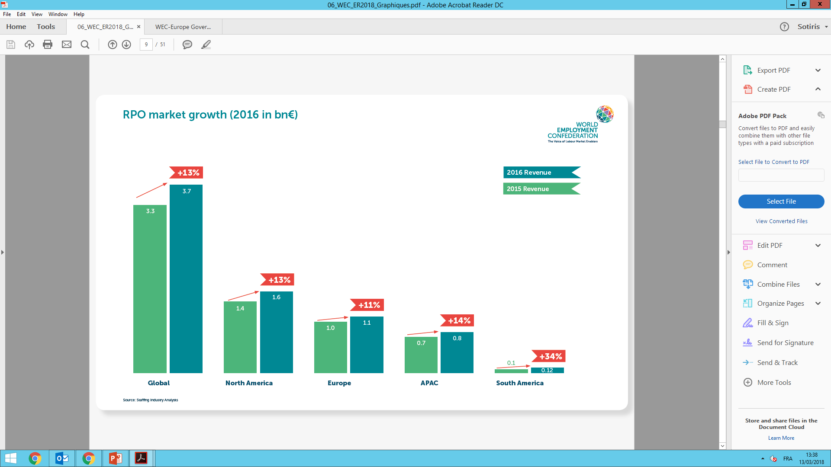
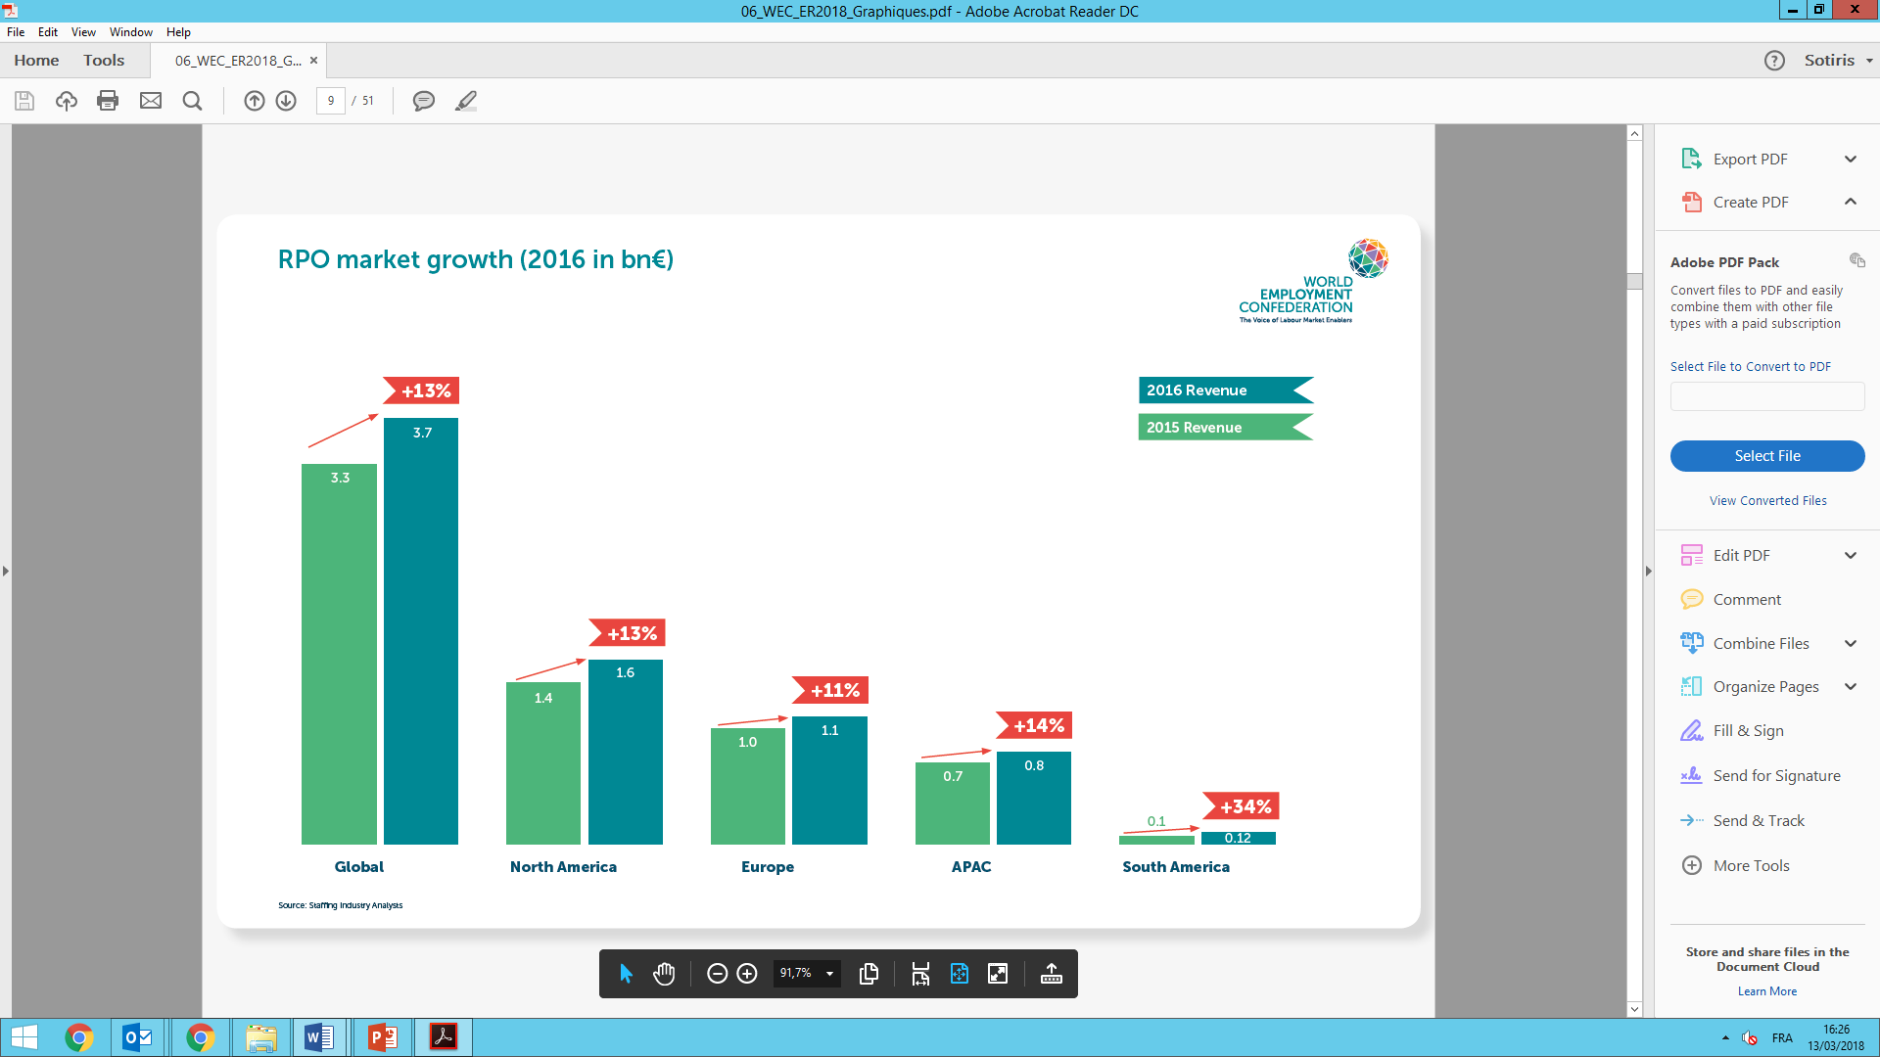
The RPO market
Global RPO market on the rise (+13%) across all regions

Slide 24
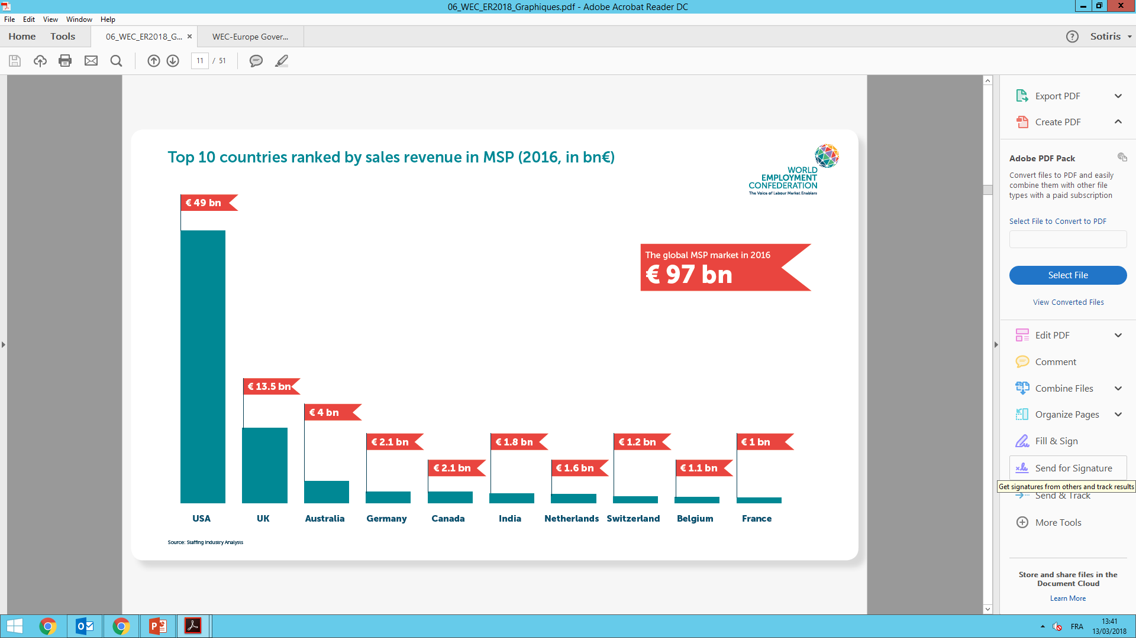
The MSP market
The global market remains stable compared to the previous year.

Slide 25
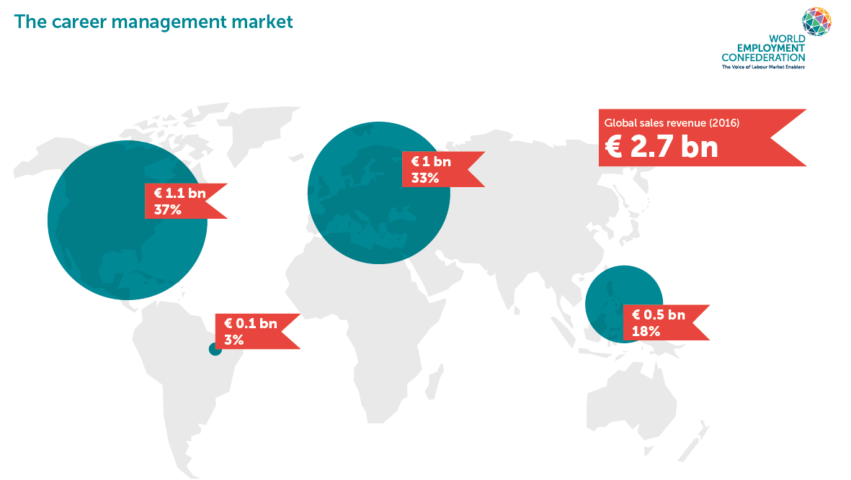

Career Management
Slight decline compared to the previous year due to some extent to the recovery of the economy where outplacement is the most established.

Slide 26
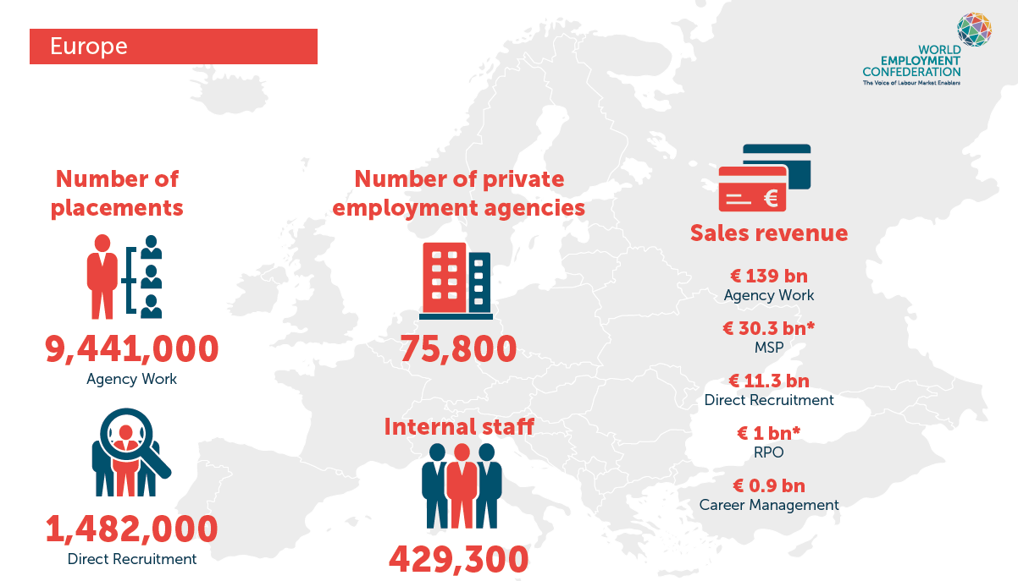
Europe
Half of the world’s best performing markets in Agency Work and 11 out of the 15 best performing markets in Direct Recruitment are located in Europe

Slide 27

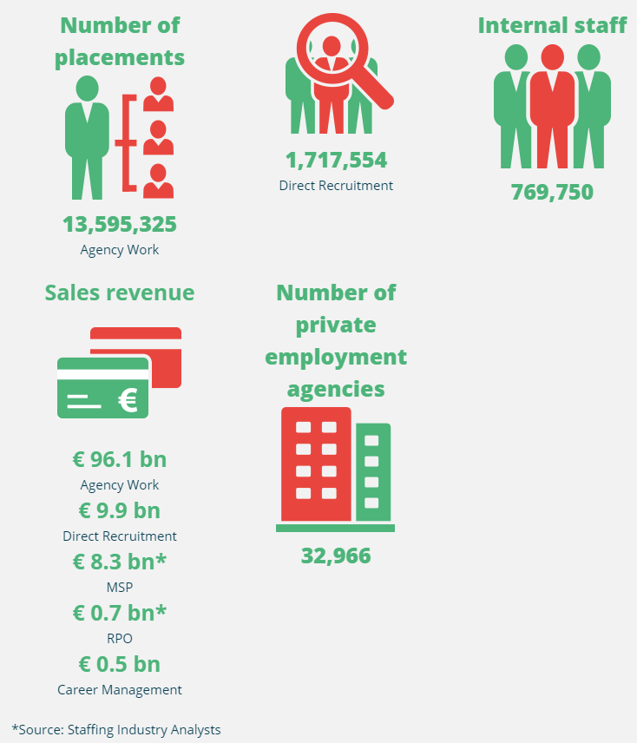
Regional Data – Asia Pacific
Japan, Australia and China are ranked among the 10 best performing markets in both agency work and direct recruitment.
Japan, the second largest market in agency work shows a solid year-over-year growth of 8% and ranks sixth amongst the best performing markets in Direct Recruitment.
Australia stands out in the Asia Pacific region as a very mature and competitive market. It holds third place in our MSP and Direct Recruitment rankings and owns the second highest penetration rate in Agency Work (3,6%).
China has moved into third place in the ranking on agency work in 2016, assisting 8 million agency workers into work. Finally, India represents an emerging market in the HR solutions industry, especially in MSP where it ranks sixth in the world.

Slide 28
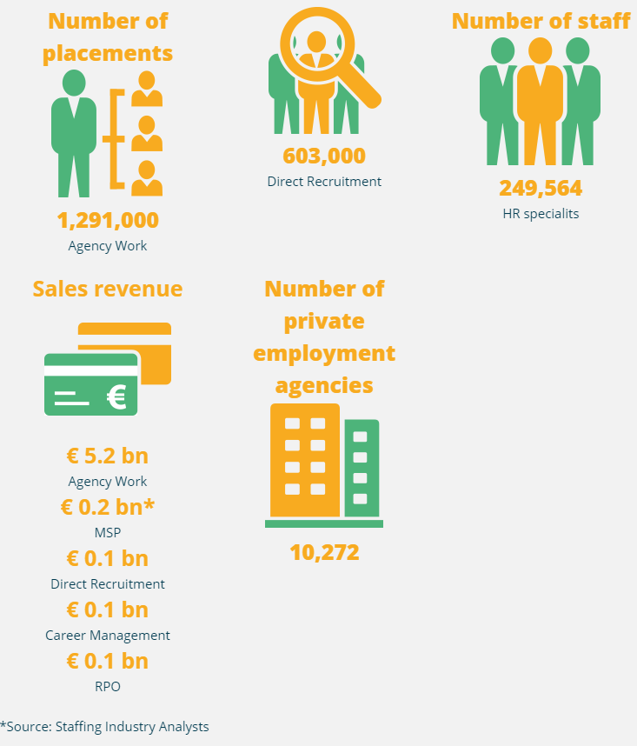
Regional Data – South America
Brazil remains the strongest market in South America, accounting for about 20% of the total revenue generated by the employment industry despite a contracting market in 2015 due to the economic crisis with no recovey in 2016. Recent legal changes (Law on Outsourcing, Extension of the Law on Temporary Work and Labor Reform) have already positively impacted the market, with a growth rate of 5% during the 4th quarter of 2017, according to FENASERHTT, the Brazilian federation member of the World Employment Confederation. Brazil has the highest agency work penetration rate in the region, followed by Colombia, Chile and Argentina, all below 1% partly due to the large amount of informal labour in the region.

Slide 29
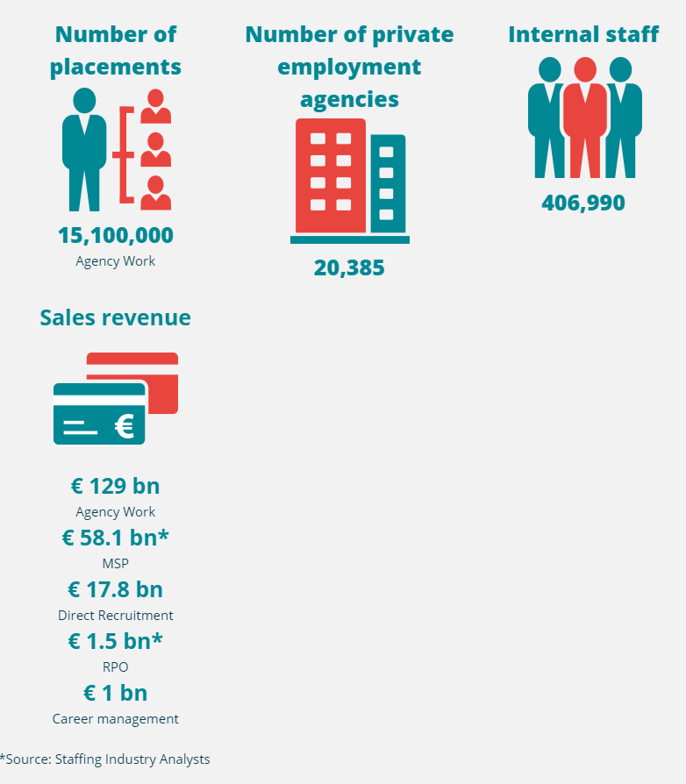
Regional Data – North America
The United States dominate the Northern American region accounting for 93% of the total revenue generated by the employment industry. Canada accounts for 6% of the Northern American market, showing a return to growth following a slight downturn in 2015. Mexico accounts for 1% of the total market and shows a 6,6% year-over-year growth in agency work compared to the previous year.

Slide 30
Governing Bodies

Slide 31
WEC Governing Bodies
Taskforces
Economic Affairs Committee
General Assembly
Corporate Members Committee
National Federations Committee
Head Office
6 FTEs
Board
(19 members)
Executive Committee
(7 officers + Managing Director )
North America
Latin America
Europe
Africa
North East Asia
APAC Southern

Slide 32








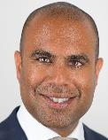







WEC Board members
North America
Richard Wahlquist
President *
Annemarie Muntz
Chair NFC *
Charles Cameron
Chair CMC *
John Healy
Europe *
Bettina Schaller
Vice-President *
Hans Leentjes
APAC Southern
Ian Grundy
The Adecco Group
Ranjit DeSousa
ManpowerGroup
Mark Toth
Quality Standards *
Vacant
North East Asia
Mio Kashiwamura
Gi Group
Antonio Bonardo
Randstad
Susanne Wissfeld
Treasurer *
Herwig Muyldermans
Africa
Jacqui Ford
* = Officers
Recruit Global Staffing
Vacant
Kelly Services
Pete Hamilton
Latin America
Miguel Perez Garcia

Slide 33







WEC Executive Committee (Officers)
Managing Director (standing invitation
to attend)
President
Vice-President
Treasurer
Chair CMC
Member
Quality Standards & Compliance Officer
Chair NFC

Slide 34






WEC Head Office Responsibilities’ split
Denis Pennel
Managing Director
Jochem de Boer
Global Public Affairs Manager
Michael Freytag
European Public Affairs Manager
Management
+ Thought Leadership
+ Governance & Financials
Global Public Affairs + Quality Standards + CMC & MSP Taskforce coordination
European Public Affairs + EU Social Dialogue Committee coordination
Gabriella Coorey
Events & Membership Manager
Aurélie Pattyn
Communications Manager
Robin Lechtenfeld
Labour Market Intelligence Officer
Back office & administration
+ Events coordination & Membership relations + NFC Coordination
Communications & PR + Career Management Taskforce coordination
Data collection & Research
+ Economic Affairs Cttee coordination

Slide 35
Services to Members

Slide 36
5 key Services to Members
Data collection
Research
Promoting common language
Participation to conferences
Profiling the HR services
Quality Standards
Best practices/
Networking
Advocacy
Thought Leadership
Lobbying to get appropriate regulation
Relations with key stakeholders
Dialogue with social partners
Positioning on changing world of work
Conferencing
Workshops
Forum
Benchlearning
Compendium practices
Social events
Code of conduct
Certification schemes
Capacity building

Slide 37
Our Unique Value Proposition

Slide 38




Stay in touch!
www.wecglobal.org
@WECglobal
World Employment Confederation
New Reality of Work

